Slide 1
Security - Networking
September 13, 2018

Slide 2
Today’s plan
Miscellaneous
Pi cluster
TCP/IP networking

Slide 3
Miscellaneous
Mailing list
Names and email

Slide 4
Introduction to the Pi cluster

Slide 5
TCP/IP Networking Basics

Slide 6
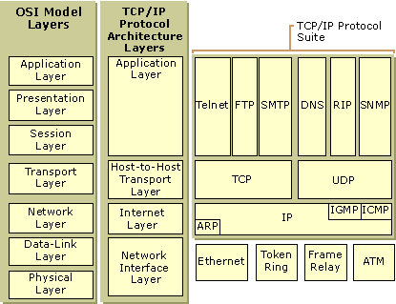
TCP/IP protocol stack

Slide 7
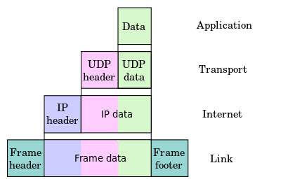
TCP/IP packet structure

Slide 8
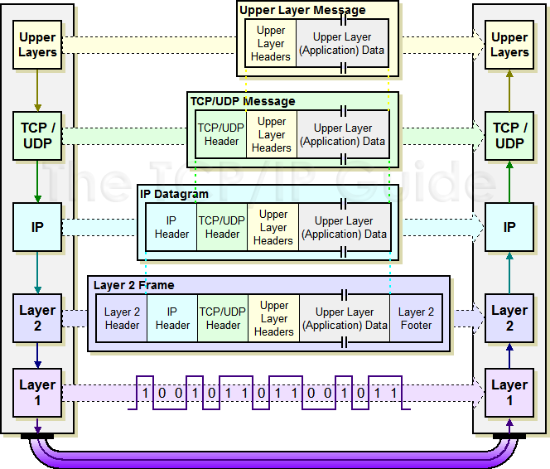
TCP/IP packet structure

Slide 9
Networking tools
Send ICMP packets with ping and traceroute
traceroute uses TTL to determine packet route
Configure network with:
ifconfig or ip addr
route or ip route

Slide 10
Demonstration of socat
Set up a tcp server:
socat tcp-listen:8080,reuseaddr,fork exec:'bc -l'
Connect to it:
echo '4 * a(1)' | socat - tcp:localhost:8080

Slide 11
Networking tasks
Send ICMP packets using ping
See what traceroute google.com returns
Install nmap, nethogs, tcpdump and socat by running
apt-get install nmap nethogs tcpdump socat

Slide 12
Basic networking tasks
Scan localhost with nmap
Start an echo server on port 8080 with the following command:
socat udp-listen:8080,fork,reuseaddr exec:cat
Try scanning localhost again
Send some text to it:
echo Hello world | socat - udp:localhost:8080
man ls | socat - udp:localhost:8080

Slide 13
Basic networking tasks
Repeat the previous tasks while running: tcpdump -i lo -s0 -XX
See what nethogs shows while you use the network

Slide 14
Advanced networking tasks
Have the TCP server modify the input with e.g. wc, grep, etc.
Try scanning with different types of probes

Slide 15
Networking
Infrastructure

Slide 16
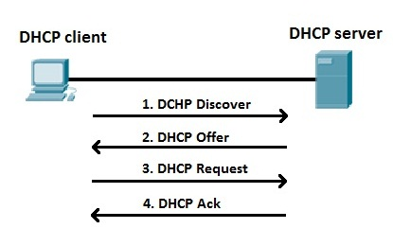
Dynamic Host Configuration Protocol

Slide 17
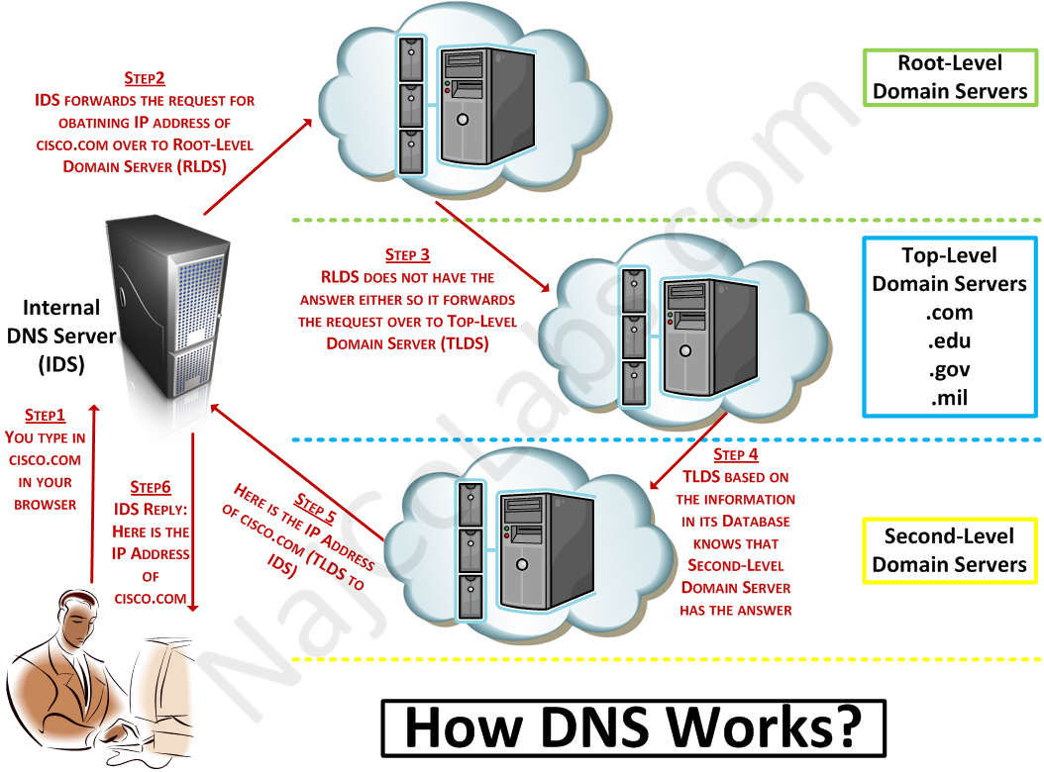
Domain Name System - How it Works

Slide 18
Domain Name System - Records
Authoritative vs non-authoritative
Name to number (A and AAAA)
Number to name (PTR)
Other types (MX, NS)
Root level domain servers
Top level domain servers

Slide 19
Domain Name System - Commands
dig +trace www.google.com.
host -a www.google.com.

Slide 20
Domain Name System - Tasks
Make DNS queries with dig and host on google.com
Lookup the NS, MX and A records of your home Internet Service Provider (ISP)
See if your ISP is censoring some hostnames, e.g. thepiratebay.org

Slide 21
NAT
Network
Address Translation

Slide 22
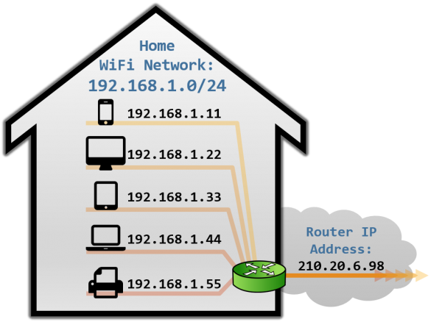
Network Address Translation
Test with traceroute
SNAT vs DNAT
SNAT vs MASQUERADE

Slide 23
NAT - examples with iptables
iptables -t nat -A POSTROUTING -o $EXTERNAL_NIC -j MASQUERADE
iptables -t nat -A PREROUTING -d $EXTERNAL_IP -j DNAT --to $INTERNAL_IP

Slide 24
Local Link Networking

Slide 25
Local link networking
Old protocols (80s)
NetBeui (Windows native)
Appletalk (Misc. native)
IPX/SPX (Novell)
New protocols (00s)
UPnP (Windows native)
Zeroconf (OSX native “Bonjour”)

Slide 26
Local link networking
Why local link - auto discovery
Printers
Entertainment systems
Home automation
Service discovery
Why not
Security

Slide 27
Local Link Networking - Examples
Automatic address assignment
mDNS – multicast DNS
DNS-SD (Apple), SSDP (Microsoft) - service discovery

Slide 28
Local Link Networking -
Linux commands
avahi-daemon
Communicates with other hosts through multicast 224.0.0.251
avahi-browse
List devices and services that support zeroconf
avahi-autoipd
Fallback to an available 169.254 address if there is no static address or DHCP fails
avahi-resolve
Translate between IP address and hostname or vice versa

